Slide 1
Clevart: Adaptive In-Store Shopping Guidance System
Team ArchWorks
Ayed Sultan Al-Mutairi
Yousof Osama Dardir
Khalid Fahad Abu-Shaibah
Yousef Naif Al-Otaibi
Ali Mishal Al-Laho
Supervisor: Dr. Maha Faisal
Kuwait University - Computer Engineering Department

Slide 2
Agenda
Problem
Target Users
Objectives
Proposed Solution
System Workflow
Related Work
Competitive Advantage
Success Metrics & Constraints
Team & Outcomes
Conclusion
Khaled Abu-Shaibah

Slide 3
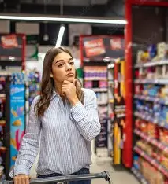
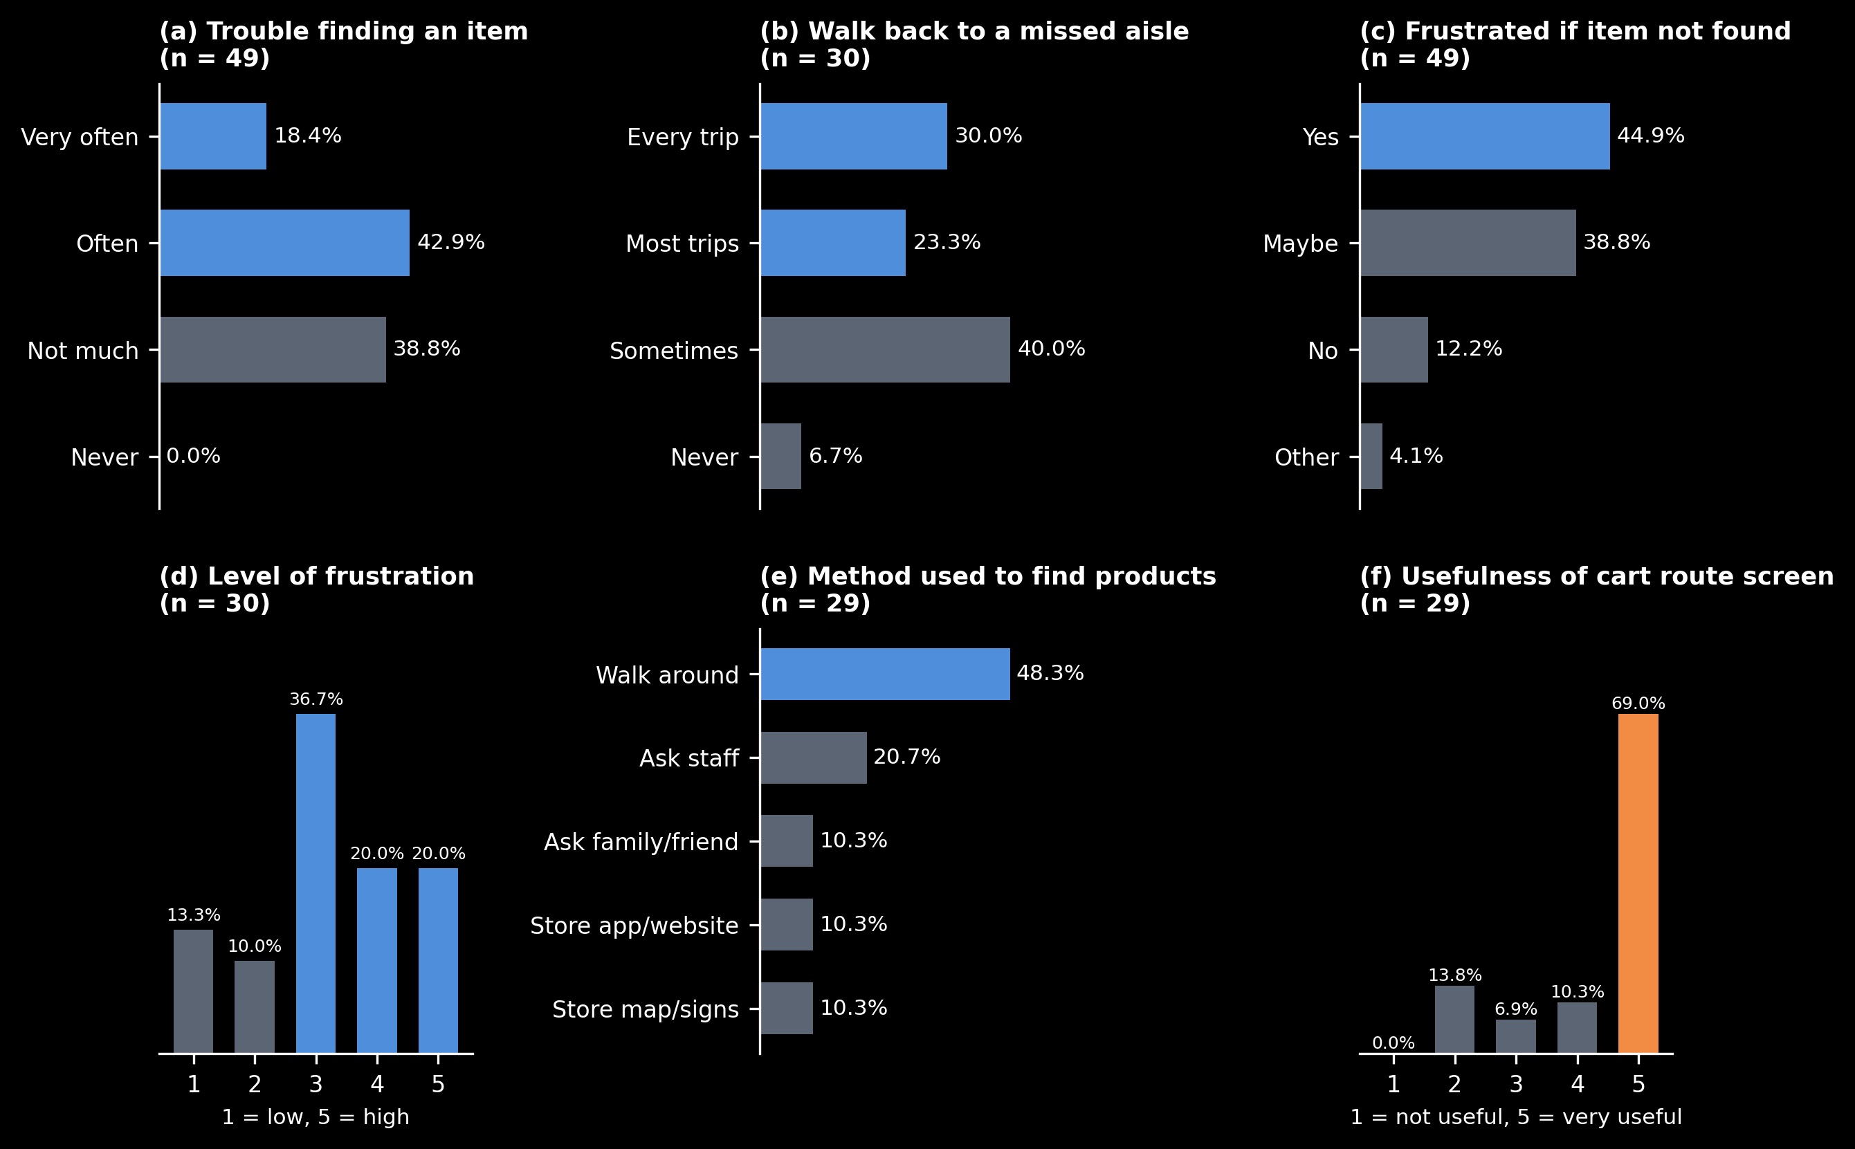
The Problem
Customers spend significant time searching for products.
Product locations frequently change.
Shoppers often backtrack between aisles.
Dependence on employees increases.
Shopping routes become inefficient in unfamiliar stores.
Ali Al-Laho

Slide 4
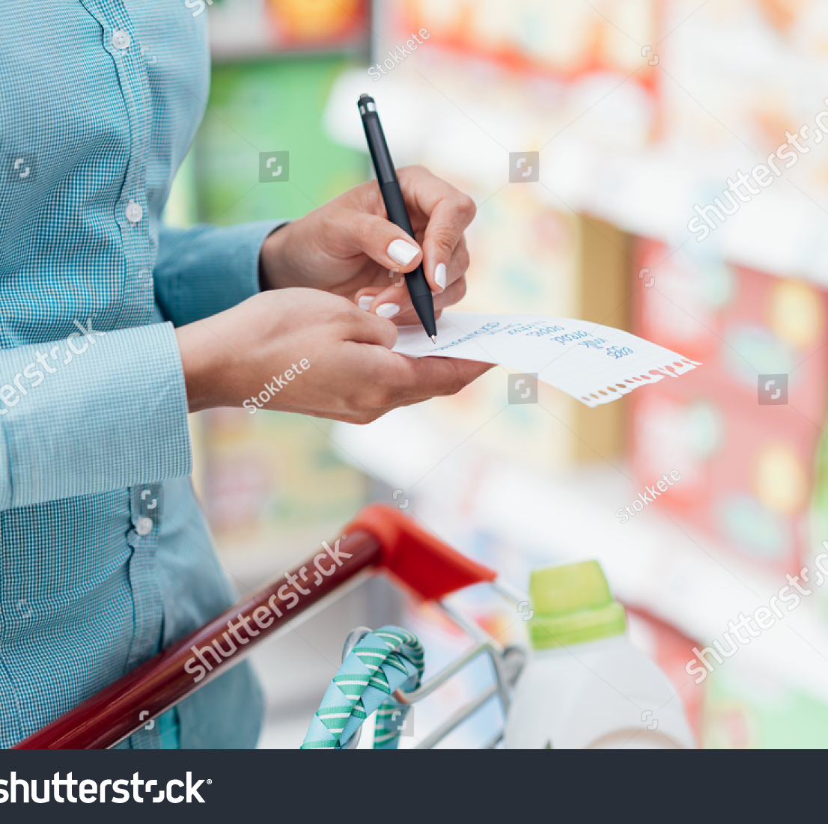
Who Is Affected?
Regular supermarket shoppers
First-time visitors
Customers with large shopping lists
Shoppers unfamiliar with store layouts
Effects
Longer shopping trips
Increased walking distance
Missed products
Customer frustration
Ali Al-Laho

Slide 5
Objectives
Main Objective
Reduce product-search time and unnecessary walking using adaptive guidance.
Secondary Objectives
Accurate product location.
Dynamic route planning.
Purchase tracking.
Spending monitoring.
Reduced employee dependence.
Yousof Al-Otaibi

Slide 6
Our Solution at a Glance
Clevart
Clip-on smart device attached to supermarket carts.
Features:
Indoor Positioning
Product Database
Dynamic Routing
Shopping List Tracking
Purchase Monitoring
Real-Time Route Updates
Yousof Al-Otaibi

Slide 7
How It Works
Workflow
Create Shopping List
⬇
Detect Cart Location (BLE)
⬇
Retrieve Product Locations
⬇
Generate Optimal Route (A*/Dijkstra)
⬇
Collect Products
⬇
Scan Purchased Items
⬇
Update Shopping List
⬇
Recalculate Route Dynamically
⬇
Shopping Completed
Ayed Al-Mutairi

Slide 8
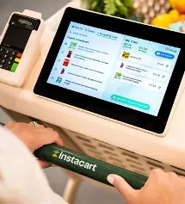
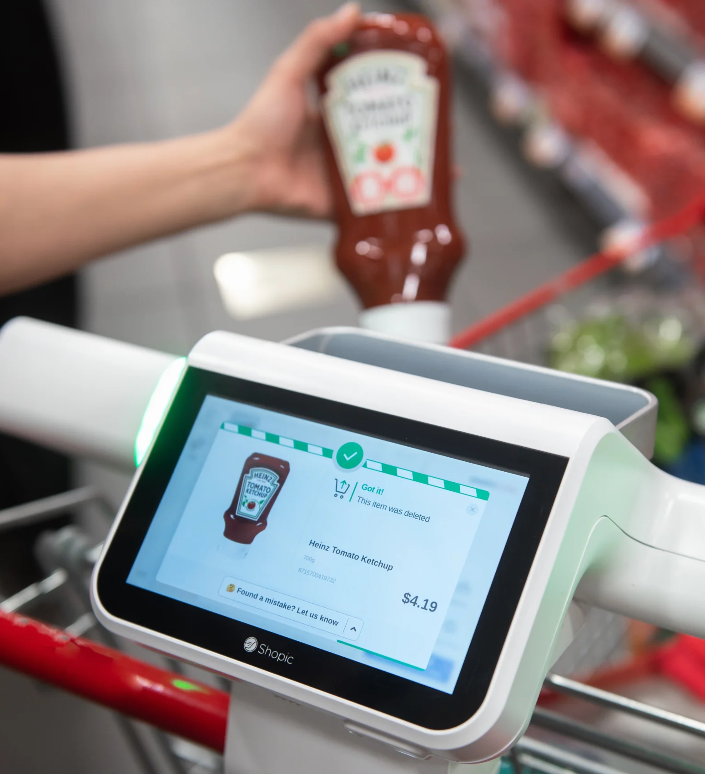
Related Work
SmartMart
GroFin
CAST
Coles Smart Cart
Shopic Smart Cart
Woolworths Scan&Go
Techno M-Cart
Ayed Al-Mutairi

Slide 9
How We Are Different
Key Advantages
✅ Adaptive route recalculation
✅ Indoor shopper localization
✅ Clip-on design
✅ Product-location database
✅ Dynamic shopping-list routing
✅ Reduced backtracking
Ayed Al-Mutairi

Slide 10
Measuring Success & Constraints
Success Metrics
Search time
Walking distance
Backtracking events
Successfully found items
Constraints
Existing cart compatibility
Cost limitations
Battery life
Positioning accuracy
Safety & Usability
Yousof Osama

Slide 11
Team & Expected Outcomes
Expected Deliverables
Clevart Prototype
Product Database
BLE Localization Module
Route Planning Engine
Cart User Interface
Team Strengths
Programming
Networks
Databases
Machine Learning
Embedded Systems
Yousof Osama

Slide 12
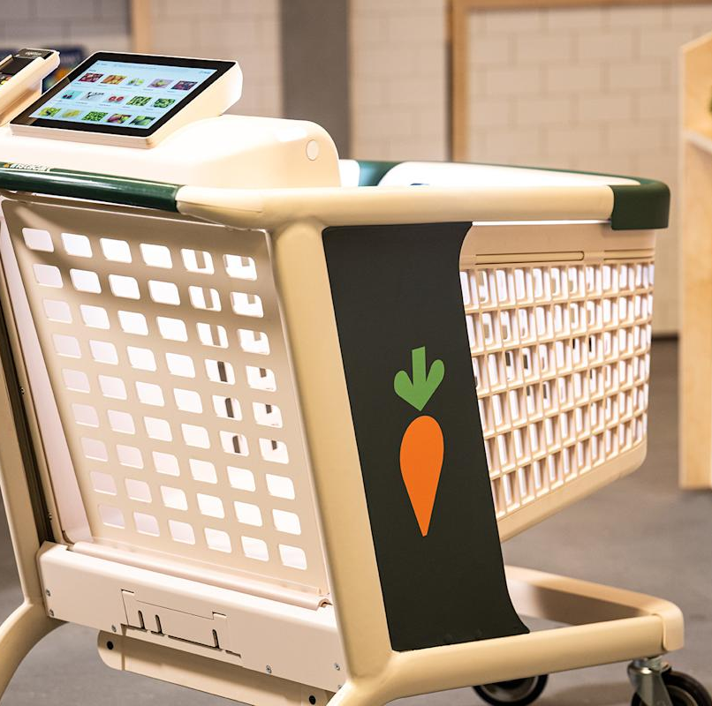
Conclusion
Clevart combines:
Indoor Localization
Product Database
Adaptive Routing
Purchase Tracking
to improve supermarket shopping efficiency and reduce search time, walking distance, and backtracking.
Future Goal
Deploy a scalable smart-cart solution for real supermarkets.
Yousof Osama

Slide 13

References
SmartMart (2013)
GroFin (2019)
CAST (2010)
Instacart Smart Cart (2025)
Shopic (2024)
Woolworths Scan&Go
Sakman et al. (2023)
Picinin et al. (2025)
Liang et al. (2025)

